Slide 1
WPPC AGM 2021
WPPC is an independent, volunteer
environment group founded in 1971 celebrating 50years
Photo

Slide 2
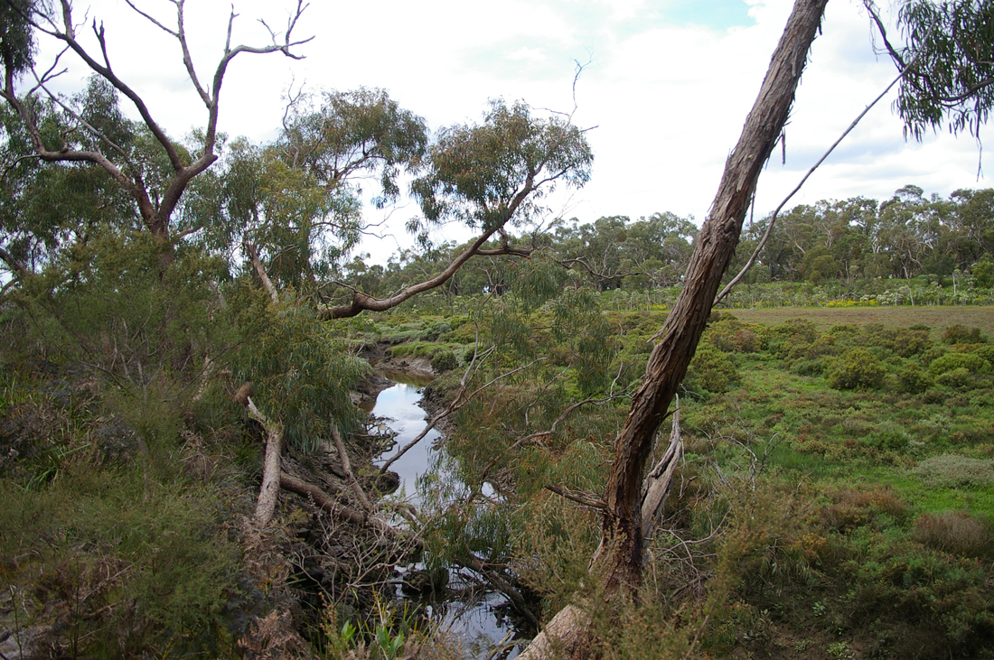
We acknowledge the Bunurong and Boon wurrung as the custodians of this land and wish to show our respect to elders past and present.
Watson Inlet photo Biosphere website
Notes:
read

Slide 3
Agenda for AGM February 21st 2021 Balnarring Hall
Welcome
Report for 2020
Showcasing some work
Apologies
Minutes of last AGM
Treasurer's Report
Election of Office Bearers
What is coming up
Ideas from Members
Guest Speaker – Gidja Walker
Close

Slide 4
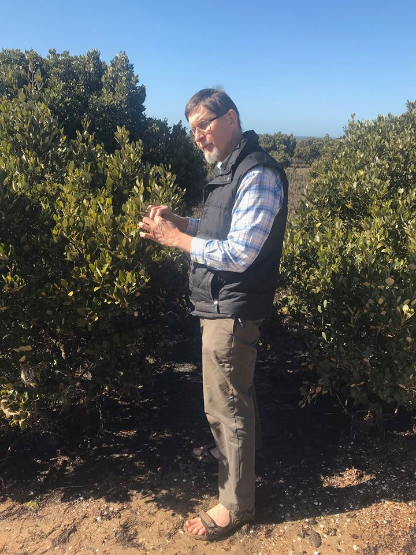
VALE Chris Chandler
WPPC Committee member and founding member of Save Westernport Chris Chandler passed away on April 30 from cancer, aged 60.
Chris was a born naturalist. He had a great ability to share his knowledge with clear explanations, as he worked tirelessly for improvements in conservation and resource management. Chris spent much of his childhood on French Island. Scientists taking part in the Shapiro Study in the 1970’s were directed to The Chandler household as his father Alan was a keen naturalist. Chris often accompanied them and helped them with their field work.
The day before he died, Chris gave instructions for monitoring the critically endangered fairy terns on French Island.

Slide 5
Report for 2021
Our Year started with our AGM where Guest Speaker Shannon Hurley from VNPA outlined the threat of marine pests and how to contribute citizen science info about marine pests in Westernport. The main message is that it best to find small outbreaks as soon as they happen and that ships from Japan are particularly dangerous
At a zoom meeting with the HECS Japanese companies and their PR company, Kawasaki announced that they would monitor for marine pests. This is a win for WPPC. It is a result of our initiative a joint letter signed by 9 environment groups requesting marine pest monitoring and the grant we applied for with Save Westernport, from MP Greg Hunts Office to engage Fathom Pacific to do marine-pest monitoring. We will follow up with Kawasaki.
We also found out that Bluescope pier would not be used for a commercial-scale hydrogen project so Crib Pt, being the only deep port near Latrobe Valley, would be the obvious port. This makes us suspicious that the AGL gas importation pipeline is a Trojan horse for Hydrogen exports.
We assisted Save Westernport to write a letter to The Port Of Hastings that were a bit hysterical about the prospect of us monitoring marine pests.

Slide 6
We took part in a zoom and sent Letters to State politicians and Bass Coast Councillors regarding saving The Holden Proving Grounds Lang Lang. This has been purchased by a Vietnamese car company that is retaining this bushland which is a comparable size, and more ecologically intact than Devilbend, Daangean. The group is now called Save Westernport Woodlands and includes a chain of reserves from Lang Lang to The Gurdies. It is threatened by new sand mines that could be located on marginal farmland.
We did a Submission to the Vic Parliamentary enquiry on Extinction recommending they preserve and manage The Holden Woodlands.
We attended the Port of Hastings Stakeholder meetings
Attended the Hastings Foreshore meetings. We did a Submission to Future Foreshores
We sent a letter regarding Ryman development 38hec Mt Eliza in Green Wedge
We did a submission to VCAT over the Harkaway development
We did a submission to the DELWP Green Wedges Review
We supported Save Arthur’s Seat against an Oversize Hillview Quarry

Slide 7
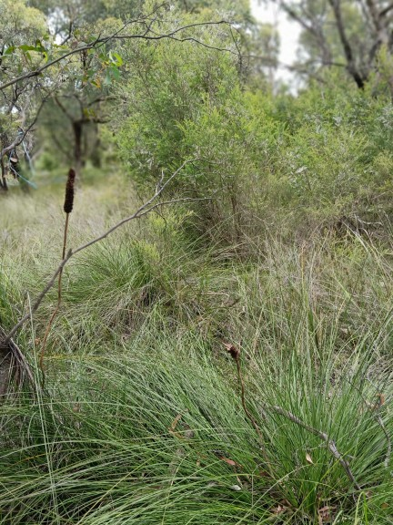
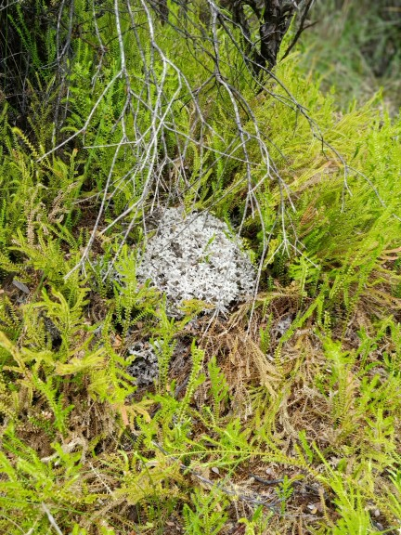
Save East Westernport Woodlands. Adams Creek Reserve

Slide 8
Karri Giles , Sandy Milne and Gidja Walker, along with our expert witness, the highly qualified Dr Mary Cole were the WPPC team for the IAC Environmental Effects Statement for the Crib pt Gas import Jetty and pipeline. Together the four of us did 580 hours of work in 2020. We took up the offer of help from two Barristers James Kewley and Kieran Hickie who did a brilliant job.
We worked on the Save Westernport Submission which was a comprehensive submission to the EES.
We then worked on our own WPPC Submission.
We hired an expert Witness Dr Mary Cole who put in an expert witness report.
We submitted another referenced report for the panel hearing
prepared our own taking notes and PowerPoints and all four of us had a 2.5hour time slot in the panel hearing to present.
Then we engaged Dr Mary to provide addition comments to AGL/ APA’s amendments as requested by the panel.
We then did a joint press release and a WPPC press release and an article for VNPA Parkwatch .
WE have joined a Mornington Peninsula Shire Council NO AGL fortnightly meeting. There is a letter for groups to endorse-ask us.

Slide 9
Summary of WPPC’s Terrestrial Concerns
1. The pipeline footprint we estimate is approximately
57kms x 30 metres wide = 171 hectares.
A figure for the total vegetation loss did not appear to be available in the EES documents. We requested that information from APA on the 12th of November. APA referred us back to Brett Lane’s documents for the proponents ‘revised native vegetation loss’ figure 17.9 ha.

Slide 10
2. This project could introduce Phytophthora cinnamoni and Amphibian chytrid fungus, which are threatening processes under the Environmental Protection and Biodiversity Conservation Act that act as a slow burn, impacting much, much wider than the initial footprint. High status bushland adjacent to the pipeline could die-off from these proposed works which is unacceptable.
3. The threat to asparagus businesses from Phytophthora cinnamoni is unacceptable.

Slide 11
4. There are 42 Flora and Fauna Guarantee listed and EPBC listed species (ALA) that have been sighted within 200m of the footprint, The significance of species present under threat from: habitat loss, fragmentation, pathogens, interruption of breeding cycles. Problems with water availability, bad water quality, and predation, means this project should be stopped.
5. Mitigation Measures are inadequate and not always in line with guidelines or previous standards.

Slide 12
6. Noise mitigation is earmarked for human settlements (only) by putting generators in containers. Noise mitigation should be used for wildlife.
7. When questioned Brett Lane agreed that revegetation should be done under an EPR. We believe that it, and restoration needs to be maintained for 10 years. It should all be done in line with the National Restoration Standards .

Slide 13
10. The DELWP submission started and finished with the impact from the Gas import Jetty. There was no submission from The Department of Environment about the effects of the pipeline.
For the panel to make their determination in this Environmental Effects Statement Hearing
WPPC believe it requires:
1. A list of listed species in the pipeline footprint
2. Zoologists to present on these species to the panel

Slide 14
11. Drilling and boring are put forward as the main mitigation Measures. They come with risks with significant consequences, i.e. frack outs. especially in these soils prone to acid sulphate and two deadly pathogens Then the pipeline easement may continue to be driven on and slashed and act as a predator corridor. This means that the project’s main mitigation is a half measure.

Slide 16
13. Though disturbed, The Tyabb Waterholes in the Watson Inlet area was obviously an important Aboriginal historical site. The registered aboriginal archaeological site is on the contour above it, probably where the camp site was. It is marked on the earliest maps. Tyabb means waterhole or mud hole. It is on the edge of saltmarsh, messmate forest, a protected estuary and a swamp. Sending a pipeline through anywhere near this is not acceptable.

Slide 17
Southern/marbled Toadlet Pseudophryne semimarmorata
Notes:
We need to mention Southern or marbled Toadlet. It is also susceptible to chytrid fungus and is of State significance on the Flora and Fauna Guarantee. It has a poor trajectory for survival according to Brett Lane so needs to be factored in. It is a very different animal to Growling Grass Frog as it walks rather than hops, is smaller and lives in a different range preferring ephemeral wetlands.

Slide 18
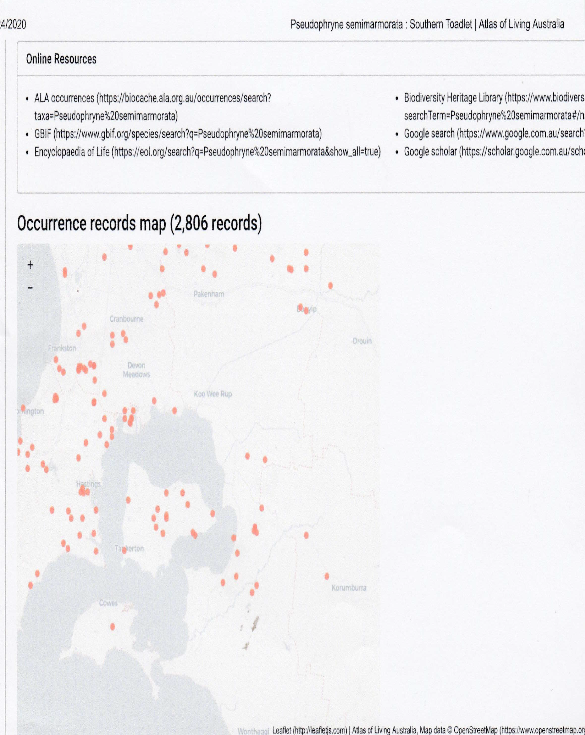
Notes:
You can see Southern Toadlet is distributed through the southern half of the pipeline area. This frog needs to be dealt with and we suggest Frog scientist need to provide evidence to the this panel about this frog, as we don’t have time.

Slide 19
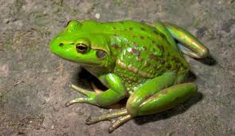
Growling Grass Frog/ Southern Bell Frog Litoria raniformis
Notes:
This frog is large 10cm and beautiful, as a fierce hunter it fills a niche that cannot be replaced by frogs not susceptible to chytrid. (check)

Slide 20
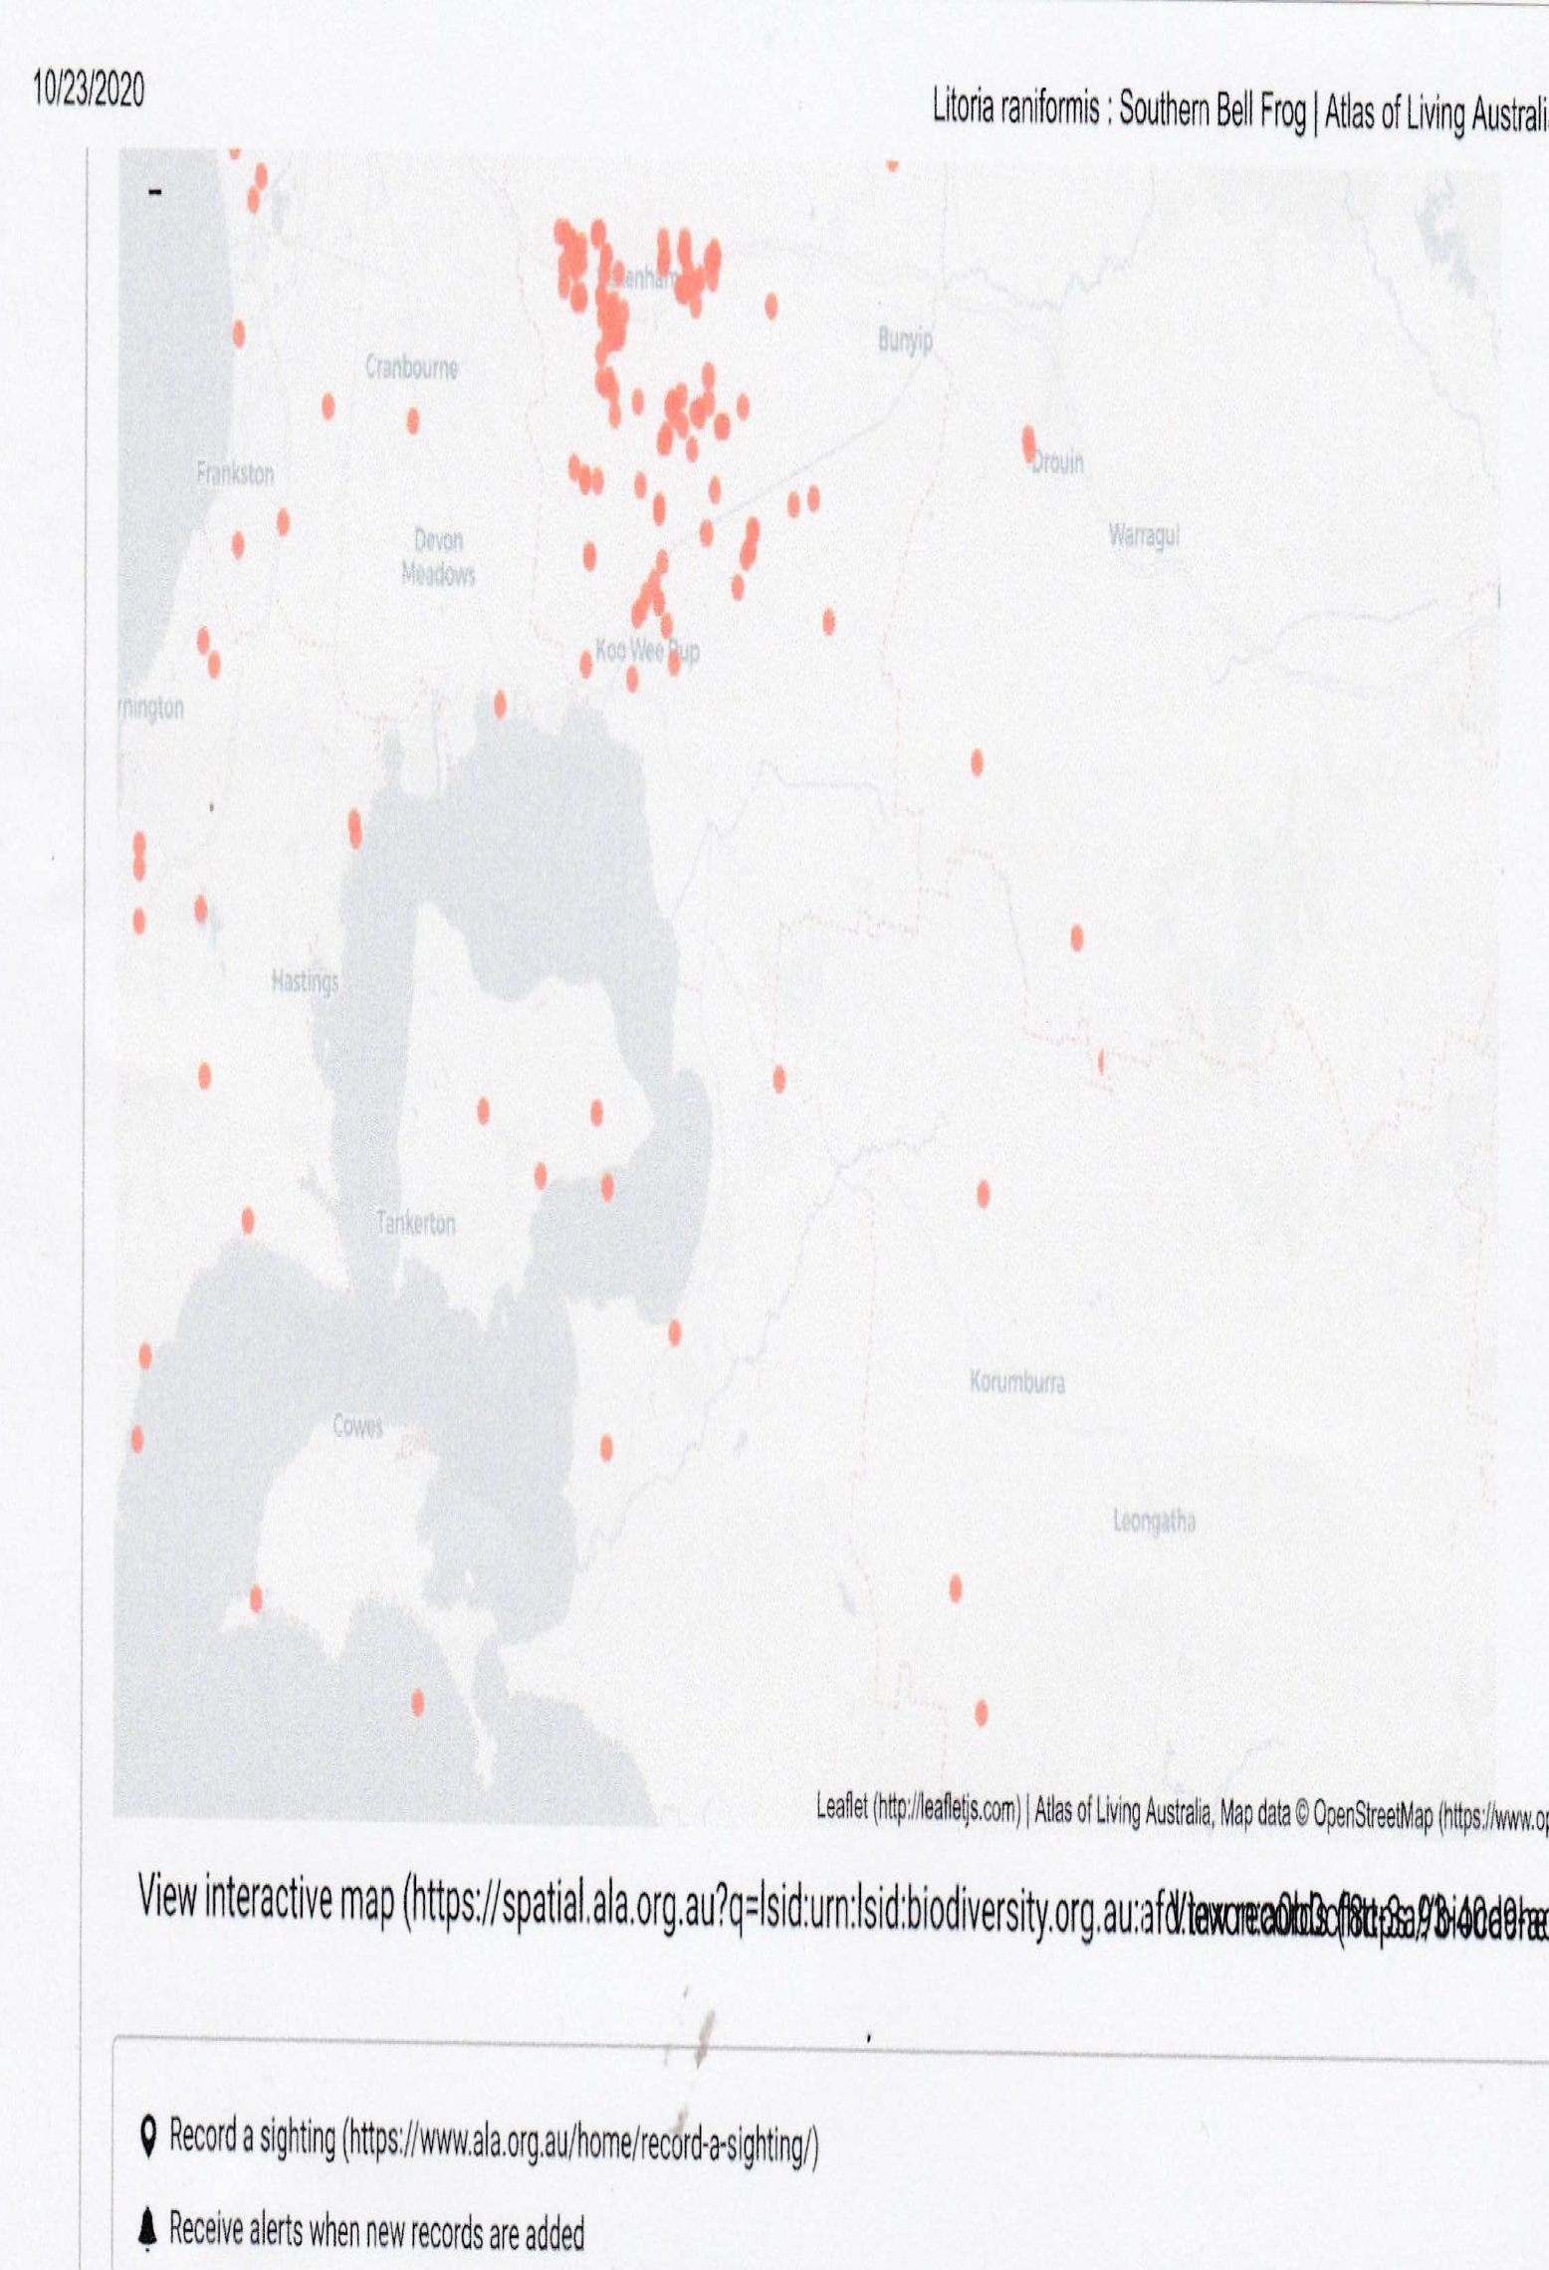
Notes:
This is a distribution map from Atlas of Living Australia. You can see the pipeline goes diagonally through this important population. There are frog movements throughout this area that could spread pathogens.

Slide 21
Swamp skink - Lissolepis coventryi

Slide 22
Summary of our concerns re EES
Inadequate baseline data - where are the skinks now?
Inadequate risk assessment –non-factual assumptions
Unrealistic proposed management and monitoring
– project priorities/vs environmental concerns
Cumulative risk and risk management
- predator corridors, combined impacts on vulnerable species

Slide 23
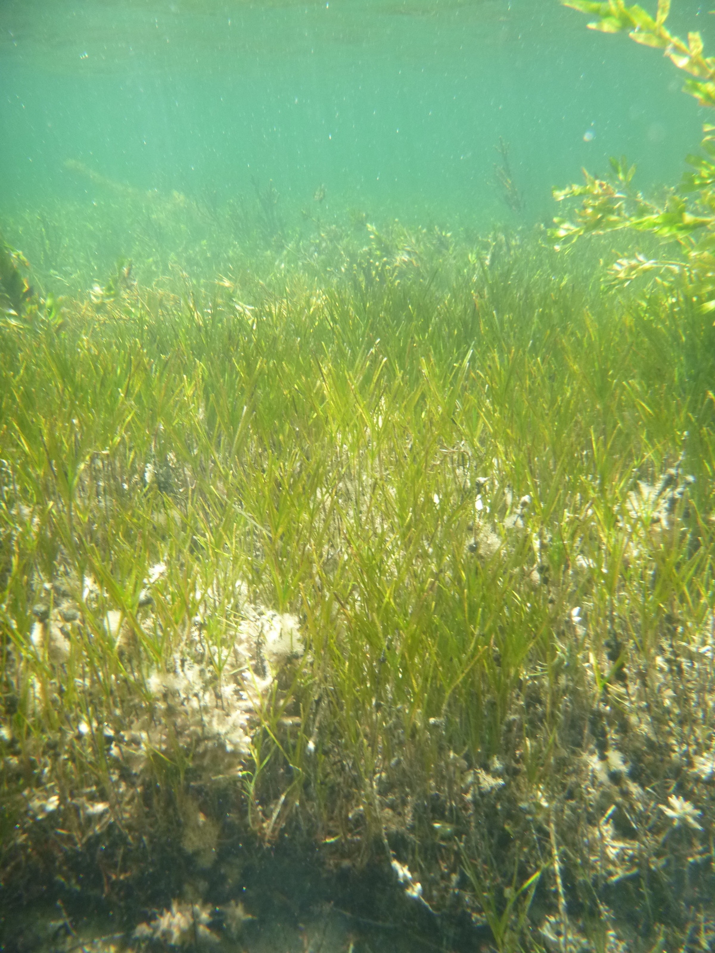
Apologies
Peg McQuire
Sue Boggan
David Minton
Penny Johns
Anthea Swan

Slide 24
WPPC Inc. 2020 AGM Minutes of Meeting
Date/Time | 12.01.20 10am | Location | Balnarring Hall
Attendees | WPPC Committee, General Membership and members of the public list separate.
Guests in attendance | Guest Speaker Shannon Hurley from Victorian National Parks Assoc Councillors David Gill and Rosemary West
Sandy Milne Opened the Meeting | WPPC Acknowledges the Traditional Owners and Bunurong Elders. Sandy noted the importance of Unity with other groups in standing up for our environment. New WPPC Members and AGM attendees were welcomed

Slide 25
WPPC Secretary Karri Giles reported on WPPC’s work in 2019 | In April and October 2019, WPPC was represented by Liz Sarrailhe & Julia Stockigt at Port of Hastings community consultation committee meetings In Feb, WPPC hosted a special screening of The Bentley Effect, a film about successful community action against AGL’s attempt to frack the Nthn Rivers Feb- WPPC and SWP took part in the Hastings Day parade for WP festival Attended FoE action against brown Hydrogen exports at Melb EPA office Presented twice to local MPS Council on marine pest threat from HESC exports, emphasising potential damage to regional tourism Mayday meeting of Flinders electoral candidates with SWP at Balnarring

Slide 26
7. WPPC’s successful grant application to Stronger Communities C’wealth Environment program to engage Fathom Pacific to monitor for Marine pest species Northern Pacific Seastar (Asterias amurensis) and Japanese Kelp (Undaria pinnatifida) at BlueScope jetty. No monitoring is carried out by industry but baseline data will be needed before Japanese hydrogen exports begin from WP for HESC pilot in 2020-21
8. In Oct WPPC and SWP hosted Energy Justice Vic Listening Tour at Balnarring Hall
9. Attended VNPA’s RALLY FOR LIFE on the steps of Parliament with conservation groups from across Victoria demanding action & stronger Environment Protection laws.
10. Working Bees on WPPC’s extensive archival materials, led by Linda with support from committee & Anna Buchorn of Balnarring Historical. Much still to be done & funding needed for protected storage and digitisation.
WPPC Secretary
Karri Giles
reported on
WPPC’s work
in 2019

Slide 27
. Comments | Roger Richards notified the meeting of the recent unexpected death of Clive Minton, founder of Australasian Wader birds study and successful French Island cannon netting project. WPPC Treasurer of 15 years, Sheila Kerr passed away too young from cancer. Members of WPPC attended Sheila’s funeral. She was greatly loved and appreciated Sandy announced that Kathie Strictland passed away. Kathie and her partner Peter wrote and illustrated Plants of The Mornington Peninsula used their extensive knowledge of indigenous plants to develop foreshore management plans Attendee Rosemary West announced the death of Barry Rose, instigator of Green Wedge planning laws that protect against over urbanisation Karri noted WPPC’s long-standing working relationship with VNPA and introduced Shannon Shannon Hurley, Victoria National Parks Association’s Nature Conservation Campaigner spoke on the importance of protecting Westernport from infestation by invasive pest species. Liz thanked Shannon for her speech

Slide 28
5. Election of Office Bearers by Rosemary West | President: Louise Rawlins was re-elected Secretary: Karri Giles also re-elected Treasurer: Sandy Milne was elected The WPPC Committee was unanimously voted in: 1. Annabel Rogers 2. Liz Sarrailhe 3. Suze Kepert 4. Meg MacMillan 6. Julia Stockigt 7. Cheryl McDonald
6. Minutes of Previous AGM | Karri moved that the Minutes be accepted, seconded by Julia
7. Apologies | Chris Chandler, Anthea Swan and Henry Broadbent. Penny and Murray Johns, Merran Samuel.
8. Treasurer’s Report | Annabel presented the Treasurer’s report, and expressed appreciation for Henry Broadbent’s work as WPPC Treasurer. Sandy moved to accept the 2019 Treasurer’s report, seconded by Liz
9. President’s Report | presented by Louise Rawlings

Slide 29
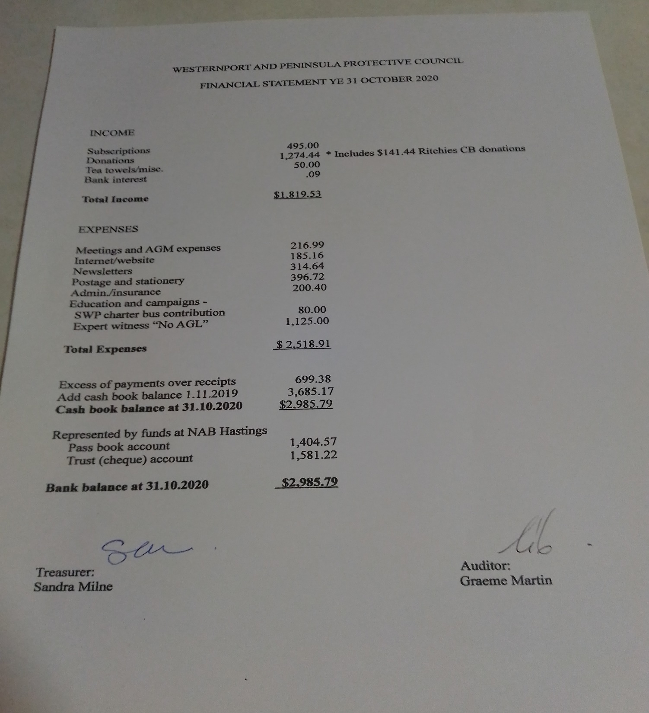

Slide 30
Treasurer’s report 2020 year. Sandy Milne Teasurer
WPPC remains a viable, active organisation, keeping a small but consistent cash balance. We continue to trend slightly downwards in our cash balance, which at 31 October was $2985.79, around $700 less than last year.
Our plans to address this downward trend by fundraising activities were thwarted by COVID, but we’ll address this in 2021.
Apart from once off activities, our biggest annual expense remains the printing and mailout of newsletters – but this is an important communication tool. Around a third of our members don’t have email addresses.
We continue to enjoy a loyal core membership base of around 200 people, although our annual subscription payment rate could be better. We’ll look at a membership/subscription drive this year, alongside our 50th celebrations.
We also aim to promote the Ritchie’s community benefit card to provide some regular ‘bread and butter’ income; as well as being more visible online and in person at some specific WPPC events throughout the rest of the year.
We are grateful to a few supporters for some generous donations that helped to fund our expert witness in the AGL IAC hearing. SPIFFA, a long-timer collaborator, also contributed towards the cost.
Thanks again to Graeme Martin, who independently audits our books and has once again signed off on this year’s statement.

Slide 31
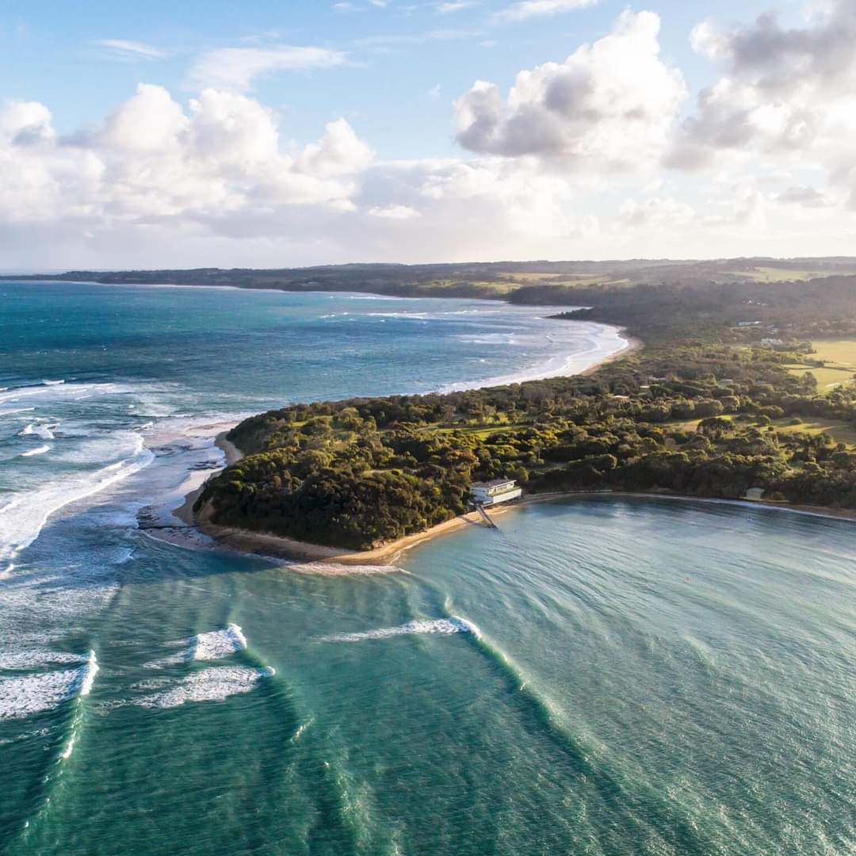
Election of Office Bearers

Slide 32
Election of Office Bearers
This year we say good bye to Cheryl McDonald who has resigned from the committee.
We thank her for her work and initiatives like sending updates out after our committee meetings. A WPPC tea-towel is in the post for her.
Nominations for all committee positions have all been filled. If you would like to become more active with WPPC please email us for a chat on wppcweb@gmail.com or talk to any committee members. We happily welcome Sue Deland, who served on the Balnarring Beach Resident’s Association and worked at Peninsula Bushworks.
President Louise Rawlings Proposed Sandy Milne seconded Liz Sarrailhe
Secretary Karri Giles Proposed Annabel Richards seconded Liz Sarrailhe
Treasurer Sandy Milne Proposed Annabel Richards Seconded Liz Sarrailhe
Assistant Treasurer Annabel Richards Proposed Julia Stockigt seconded Karri Giles
Membership Secretary Sue Deland Proposed Karri Giles Seconded Annabel Richards
Committee Liz Sarrailhe Proposed Annabel Richards Seconded Sandra Milne
Committee Meg MacMillan Proposed Karri Giles seconded Liz Sarrailhe
Committee Julia Stockigt Proposed Karri Giles Seconded Annabel Richards
Committee Suzie Kepert Proposed Karri Giles Seconded Julia Stockigt

Slide 33
Coming up
Volunteering Innovation Fund
In October we applied to Parks Vic for one of their Volunteering Innovation Grants ($10k).
To support our 50th year, we want to record interviews with our past (and some current) members to celebrate their contribution to the environment, show their passion and encourage new volunteers to work with us on a range of options – such as “citizen science”, webinar production, links to schools/TAFE and social media. We want to focus a bit more on the educational part of our mission.
We weren’t successful this time, but the panel liked our idea of interviewing past members and wants us to re-apply, focussing more on the new/innovative ways we will engage with volunteers.
So please send us your ideas – and watch this space.

Slide 34
22nd February groups’ names and logos to Shire’s NO AGL push
22nd Feb Climate Angels at Crib Pt Midday
28th February Friends Of French Island AGM in Balnarring
3rd March Extinction Rebellion meeting Balnarring Hall 6pm
Biggest Paddle Out Wetsuits for Westernport a Letter writing push we can all be involved in 7th March to write letters to Minister Wynne and spruik for letters wearing our wetsuits or googles.
17th March Save Westernport AGM perhaps on Zoom
22nd March Dandy Premix in East Westernport Woodlands VCAT Hearing

Slide 35
Seeking your ideas:
We think it’s time to get some feedback from you - on our work, how we communicate with you and with others – and your ideas on how we can work differently with volunteers. As a small group, we want to make the best of our time.
You might just like to jot a few points on the chat section today/ or later, in an email and send them to us?
Or fill out the survey form –when it is sent to you.

