Slide 1
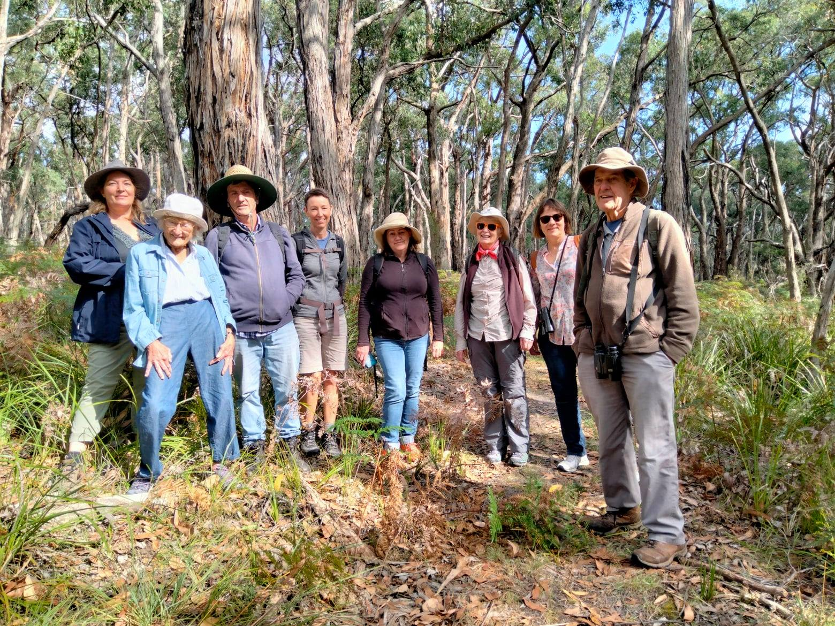
Westernport and Peninsula Protection Council April 2023 Submission to the Bass Coast Distinctive Area Landscape Plan

Slide 2
Westernport and Peninsula Protection Council (WPPC) is a not for profit, volunteer environmental group that was formed 52 years ago in 1971
WPPC will attempt today to outline some of the importance of The Westernport Woodlands in the Bass Coast Distinctive Area, to the wider region it falls in.
Because these Woodlands are so significant to South East Melbourne, The Westernport Catchment, and South and West Gippsland Regions, we ask the panel to recommend proper protection for them, taking the steps needed to provide protection for the next 50 years and ongoing.

Slide 3
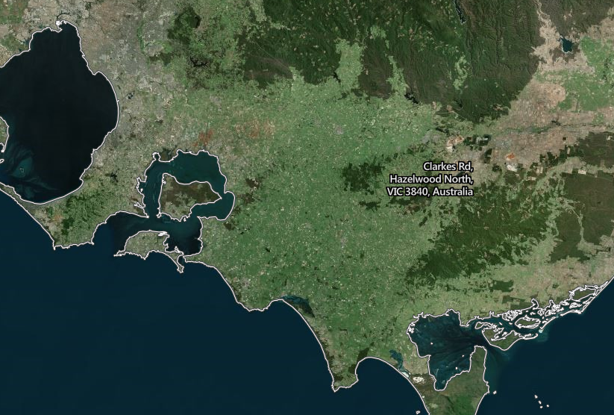

Slide 4
We showed this map at our WPPC AGM to introduce our guest speaker Catherine Watson from Save Westernport Woodlands. It was all our members needed to see to understand the importance of this remnant piece of bush, in amongst a vast area of cleared land, knowing how built up the South East corridor is: dedicated to one species, one species and their pets and stock.
We are also interested in the biolink for birds between The Mornington Peninsula and French Island and The Woodlands. We know sea eagles go from Devilbend to French Island.

Slide 5
The sand mining is suspected of leaching chemicals (used for flocculating to clean the sand), into Westernport Bay, that are potentially damaging to ecosystems.
These chemicals could be a contributing factor in the die-off of the seagrass in the North East of Westernport. Westernport Bay is reliant on the seagrass and embedded molluscs and crustaceans etc. providing an oxygenated benthos (bottom), which is the site for de-nitrification. Nitrogen in the water can cause algae blooms and it could eutrophy, causing anoxia which is harmful to humans, dead zones and dead fish. It is now in balance.
( Nutrient Transformation on intertidal mudflats of Westernport Bay Melbourne Water)
Westernport is too precious to lose.
Precious in many ways including financially (so Tim Pallas can understand).
Ten years ago WPPC commissioned The Ecosystem Service Value of Westernport Bay
By New Economics Advisory Service ACF –through VNPA
WP Bay was found to be worth $2.6 Billion per year- ten years ago. Since then the tourism of Phillip Island alone has been found to be worth not $393 million per year but $1.9 Billion and The value of the carbon sequestration done by Mangroves, Seagrass and saltmarsh have been found to be much higher than originally reckoned.

Slide 6
WPPC’s 50 year vision for the Bass Coast is to protect the Westernport Woodlands by making a National Park. With sand mining removed.
It should be managed for ecology first,
secondly for education
and thirdly for recreation
No parking facilities should be created until a very careful plan for recreation is devised.
We support the Ecology Conclave’s (VNPA, Save Westernport Woodlands, South Gippsland Conservation Society etc.) views entirely.

Slide 7
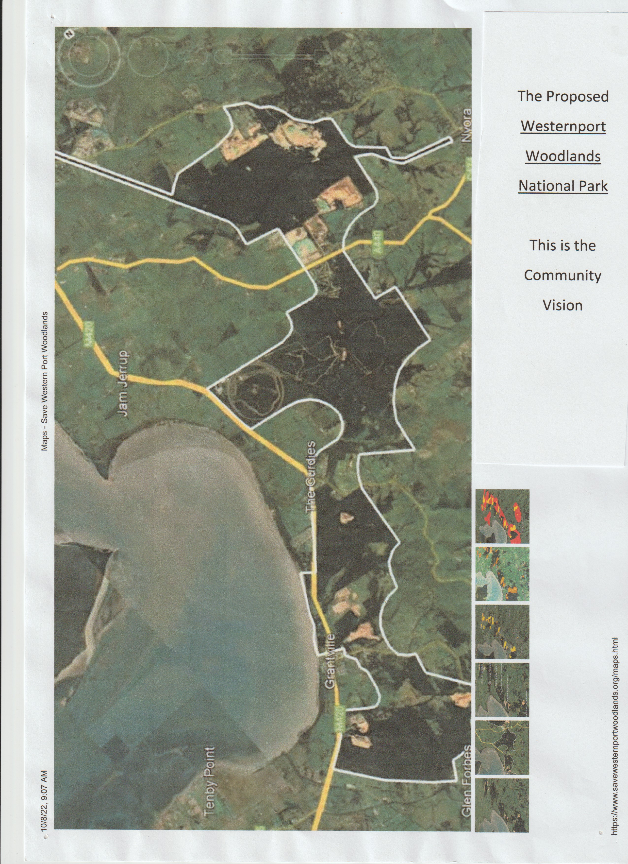
The Proposed Westernport Woodlands National Park
This is The Community Vision
The large area means less edge effect, a larger gene pool and more avenues for species to move to adapt to climate change.
Suitable areas for recreation and education could be found too.
It includes the purchase of the Holden Proving Ground that Ecologist Damien Cook says:
”Is like stepping back in time.”

Slide 8
WPPC were central in the campaign to save The Devilbend Reservoir (Daarngean) as a whole. We brought in birdo groups, horse groups, and aboriginal people and worked with fishing groups to agree to a plan. This made The State Government more willing to accept it. Now Daarngean has 50,000 visitors a year and is going well.
The Westernport Woodlands, are more ecologically important than Daarngean, so ecology has to take precedence, but the larger size of this proposed National Park could allow for recreation and education too (with careful planning).
WPPC has conducted a survey that I will summarise
WPPC have written to 22 bushwalking groups. I will run through 7 group’s responses quickly in my 17 minute talk.

Slide 9
Karri Giles Grad dip Enviro Science. Grad Dip Dance and Mvt. Dip Teach (Prim)
I am a casual relief teacher working widely in shires including Casey and Cardinia. For example I have worked in nine schools in Cranbourne alone. Families in these shires are close enough for a half day trip to the Westernport Woodlands (if there were facilities like car parks in them).
Melbourne has grown from 2 million in the 1970s to 5 Million. These families in the growth area of Melbourne are not yet in a position to realise their future need for these Woodlands let alone advocate to save them. Many of them are establishing themselves from another country, busy (and as I have gathered, very worried about snakes). Many of the kids I teach do not have back gardens to speak of. The suburbs have very small trees as the streets are too narrow for bigger ones, while their stormwater systems are well designed, many of the schools are over-crowded and some of the schools are very badly designed.
These families would benefit a lot from visiting bush areas, and Victoria would benefit from them becoming more settled, being outside more and understanding ecology more.

Slide 10
I have 6 years experience as an Environmental Educator for Dolphin Research Institute, largely on Balnarring Beach. Our team educated at least 3000 students a year.
At Balnarring Beach, during that time, I witnessed other organisations also using the place: all sorts of school groups, for camping, hiking, science studies, paddling lessons etc.
Higher Ed, using it for training outdoor education students, photography, social weekends.
Disabled groups, Elderly groups, and the outdoor kinder.
What was vital for a good outdoor venue was some beauty and biodiversity, which the Westernport Woodlands also have in spades…
and bus parking, toilets, and good paths (None of the Westernport Woodlands have all of these three things) .

Slide 11
Picture this:
A group of Year 7 Students They have back packs on and they are hiking in the Westernport Woodlands four kilometres to a campsite where they will set their tents up and stay the night.
Some students are striding along enjoying themselves, others are struggling behind. They will all make it, some will help others.
Setting up a tent and cooking a dinner, sleeping in the bush and cooking breakfast then walking out, is an experience that challenges all of them. They remember it for the rest of their lives. Some show leadership, some are away from their screens for the first time in years.
When they first arrived and got off the bus, A professional environmental educator took them on a fun nature walk. This has made them feel more comfortable; replacing fear with understanding. It has focussed them on the other species they are sharing this place with. It also covered part of their science curriculum.
They cook dinner, see the stars, and sing around a fire in a designated fireplace.

Slide 12
These students live in Casey Shire that was badly planned because of bribery to Councillors by developers, and go to a school that has 3 times as many students than for what it was designed for. The large windows for students to see the trees outside, are covered in paper because there are two lunchtimes, and teachers need to block out children playing. Their parents were born in India, Afghanistan, Samoa, and Australia, but the majority of their families have not been for a bush walk.
Some of these year 7 students go home and beg their parents to take the family to the BBQ area which is a cheapish day out, away from screens and helps the family exercise. They go on the trolley car 3kms and walk back. They start to find the bush a safe and enjoyable place.
Some of the students go on to study biology, biochemistry, anatomy virology, zoology, revegetation, climate change adaption, etc.

Slide 13
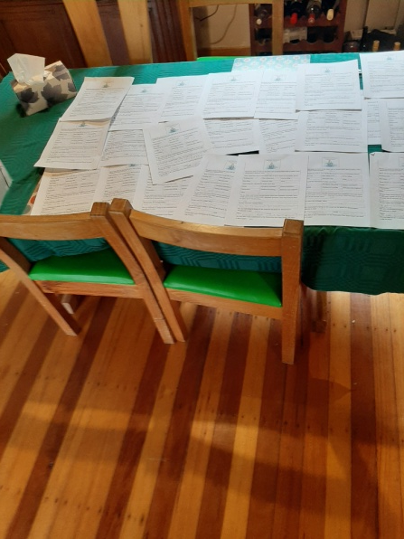
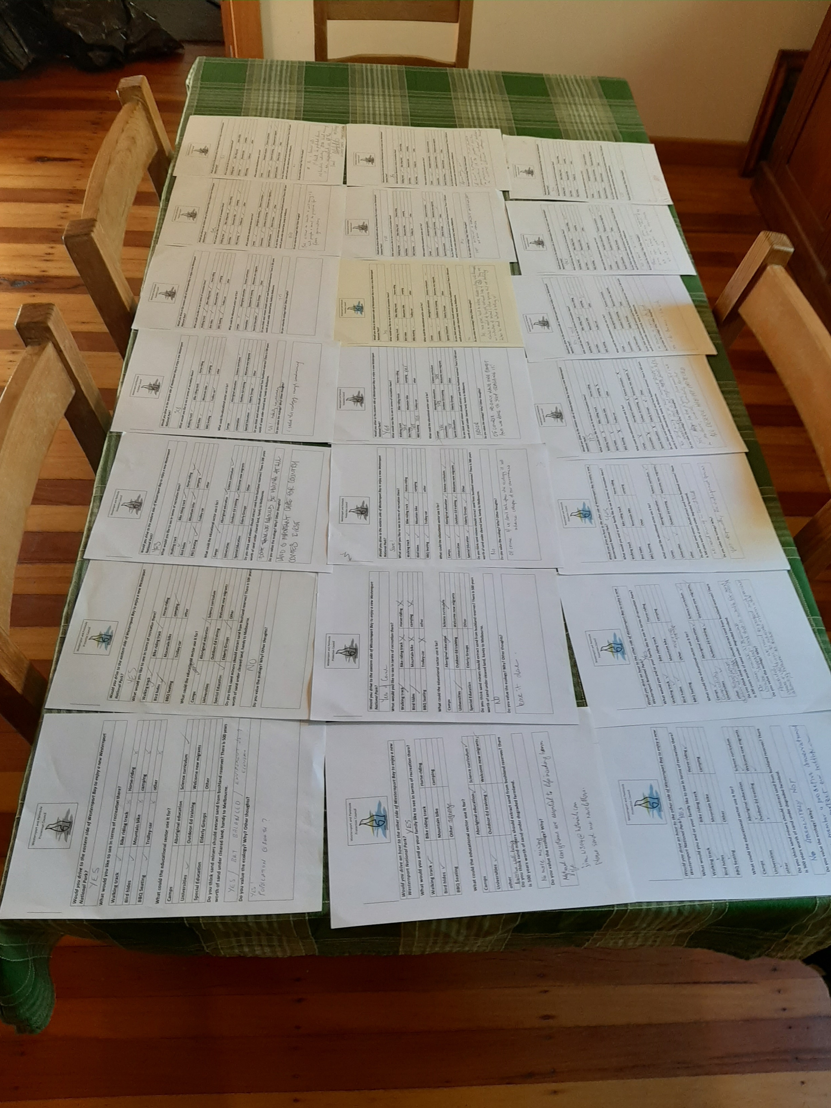
fig 6. of the 43 WPPC Westernport Woodland surveys filled out at our WPPC/ Save Westernport Stall at the Balnarring Kinder Womin Djeke Festival by members of the Public in Mid March 2022 And March 2023.

Slide 14
WPPC Westernport Woodlands Survey Summary following is a summary of 43 responses:
Would you drive an hour to the other side of Westernport Bay to enjoy a new Westernport National Park.
Yes 86% Blank 14%
What would you and or your family like to see in terms of recreation there?
Walking tracks 100%, Bird Hides 86%, BBQ seating 57%, Bike Riding 49%
Camping 43%, Mountain Bike Riding 30%, Horse-riding 23%, trolley car %14
Other bush foods and signage, conservation

Slide 15
What could the educational sector use it for?
Aboriginal Education 79%, Science Curriculum 77%, Camps 74%, Outdoor Ed Training 72%, Universities 60%, Welcome new migrants 53%, Special Education 48% Elderly Groups 38%
Other - enjoy nature passively

Slide 16
Do you think Sand miners should extract sand from bushland reserves? There is 500 years worth of sand under cleared land, handy to Melbourne
No 95%
No plenty of alternative sites
No sand mining in or near remnant forests or woodland, there is not enough forest left.
In a circular economy government industry should develop glass recycling for use in construction.
No sand mining in bushlands. Utilize ‘degraded ‘land that is suitable for sand mining.
No because it ruins the land
No sandmining in bushlands
Elsewhere- Not from Bushland reserves

Slide 17
Do you value ecology: Yes 93% Three people left it blank
Yes vital for our continued existence
Biodiversity is essential for the future of the planet
There is so little left.
Natural ecosystems are essential to life, including human life
The natural environment is critical to our physical wellbeing
Yes! Tea tree fingers, lace monitors, close to Melbourne, orchids, wombats, koalas, ALL DESERVE HABITAT PROTECTED
Yes I want to preserve it for future generations
Absolutely- we need to protect such precious areas and use them to educate inform while allowing nature to thrive.
Yes especially endangered species

Slide 18
Are you interested in being on an email list for a Picnic for the Woodlands in July -18 out of 22 left their email addresses. This wasn’t included in the second version (Which was a regrettable oversight. This is perhaps the most telling sign of their investment in this issue and 82% is huge). 82%
Are you interested in being on an email list for a Picnic for the Woodlands in July?
18 out of 22 left their email addresses. 82% This wasn’t included in the second version of the survey (Which was a regrettable oversight). Giving us their email address is perhaps the most telling sign of their investment in this issue and 82% is huge.
We also had a letter writing stall at the Balnarring Primary School Fair in Spring and many letters about this issue went off to Premier Daniel Andrews.

Slide 19
Melbourne University and Alumni Bushwalking group
Hi Caroline ,
We, Melbourne University and Alumni Bushwalking group, do support your aim to make the Westernport Woodlands a park which could be used for walking activities. Being so close to Melbourne it would be suitable for day walks.
I hope this helps you in your presentation to Bass Coast Shire. Good luck with your endeavours.
Cheers
Tricia Weickhardt

Slide 20
Koonung Bushwalking Club (based in Doncaster/Templestowe)
WPPC Westernport Woodlands Survey
Would you drive to the eastern side of Westernport Bay to enjoy a new
Westernport National Park?
Yes! We drive anywhere up to 2hrs from Melbourne for a day walk.
What would you like to see in terms of recreation there?
Walking track - Yes, please. Preferably a single file bush track,
not shared with bikes.
camping - Yes. We often base camp for 2-3 days.
BBQ Seating - Yes. Allows families and picnic-ers some comfort.

Slide 21
Do you think sand miners should extract sand from bushland reserves?
There is 500 years worth of sand under degraded farmland.
If there are alternative areas for sand mining, why spoil a potential public recreation possibility?
Do you value the ecology? Why? Other thoughts?
There is a need for city dwellers to enjoy open spaces, bushland, and exercise. Naturally vegetated areas need to be provided for this to happen. It seems a shame not to provide another 'green lung' for the public if it is at all a possibility.
Jenny Keamy
Secretary
Koonung Bushwalking Club (based in Doncaster/Templestowe)

Slide 22
Hey Caroline I take it to the group and we are pretty much interested in all the activities.
Not sure how we can cotribute Regards, Gaz
On Sat, Apr 15, 2023 at 5:27 PM Caroline Giles <wppcweb@gmail.com> wrote:
Dear Ehsan Gazar Iranian Bushwalking Club

Slide 23
Mornington Peninsula Bushwalking Club
Would you drive to the eastern side of Westernport to enjoy a new Westernport National Park.? Yes our bushwalking club, Mornington Peninsula Bushwalking club has walked the in Bass Coast area many times… we have seen kangaroos and much birdlife... I believe the sand mine has been there long before the housing boom, but it is wise now to conserve the Bass Coast, as the Bellarine and Mornington Peninsulas are booming with people we should preserve land for birds and animals. We very much value diversity of ecology and that means preserving that natural area.

Slide 24
Peninsula Bushwalking Club
Definitely. Natural areas of bushland are critical for the preservation of local species and habitat. Access to such areas helps people to value the natural landscape and support its preservation. Activities in bushland support mental and physical wellbeing.
These activities should be designed for minimum impact, which is why I said yes to walking and cycling but not to mountain bikes and horse riding.
Angelica Mason
Peninsula Bushwalking Club

Slide 25
WEST GIPPSLAND BUSH WALKERS INC
http://wgbwc.clubexpress.com
A0036428C
ABN 14 449 749 693
PO Box 1134, Warragul, Vic. 3820
Email: westgbwc@gmail.com
Sunday 9 April 2023
Karri Giles
Secretary
Westernport and Peninsula Protection Council
wppcweb@gmail.com
Letter of Support - Bass Coast Distinctive Landscape Planning Hearing
Dear Karri
Thank you for your letter advising us of the development of the Bass Coast Distinctive Landscape Plan and the current public consultation and hearing.
Let me tell you a little about the West Gippsland Bushwalker. We are a club of 108 members who walk every second Tuesday of the month with reconnaissance walks on the alternative Tuesday’s. On a typical Tuesday we would have 30 to 40 members walking. We walk in areas across West Gippsland including the eastern side of Westernport Bay, the Bass Strait coastline and Phillip Island.
I should also mention our club members also actively works with Parks Victoria to maintain the Lawson Falls track in the Bunyip State Park and the Friends of Mt Worth to maintain tracks in that park.
As a bushwalking club we can see and value the balance of conserving the natural environmental and its use for low impact recreational activities.
Turning specifically to the issue of the remnant Westernport woodlands. From time to time our club walks in The Gurdies Nature Conservation Reserve and Adams Creek Nature Conservation Reserve. It has highlighted to us how small these remaining fragments of woodland are and their degraded nature. It would appear to us it is time to act quickly to protect, consolidate and enhance these small areas and the development of the Bass Coast Distinctive Landscape Plan is the ideal vehicle.

Slide 26
The first step is to permanently protect these small pockets of woodland from further encroachment by high impact commercial activities such as mining and agriculture. The next step is to provide modest government funding to commence the rehabilitation of the woodlands natural environment and biodiversity and develop low impact recreational facilities. This then provides the platform for broader community support and ownership.
Our experience as a bushwalking club demonstrates the important role “Friends of Groups” can be in providing tangible community support and ownership for local areas of remnant bush, here we would cite the work of the Friends of Mount Worth and the Friends of the Lyrebird Forest Walk (near Mirboo North).
The West Gippsland Bushwalker would like to endorse the work of the Westernport and Peninsula Protection Council and in particular your presentation at the upcoming Bass Coast Distinctive Areas Landscape Plan Hearing on 18 April.
Yours sincerely
Yola Samplawski
President

Slide 27
The Peregrine Club Inc. engages in weekly bushwalks across South Gippsland. Its membership, currently at 96, is drawn from the Bass Coast Shire.
We have previously written to express our concern about plans to turn over the Westernport Woodland for sand mining and are pleased to have this opportunity to add to concerns raised by the Preserve Western Port Action Group.
Coincidently our walk last week took us around part of the boundary surrounding what was the Holden Proving Ground.
This section of the Westernport Woodland underscored to each and every one of our bushwalkers the beauty and wonder of this special tract of indigenous bushland, an area of natural woodlands, with an understory of diverse shrubs and grasses. We were struck by unseen sounds emanating from our surrounds which included chorus’ of cheerful birdsong and croaking frogs. We saw lots of evidence of wildlife and the array of native vegetation was breathtakingly beautiful, uncultivated and largely untouched by human intervention.

Slide 28
Many of us have an enduring and happy experiences of being with and in our bushland, the vista, the aromas, the buzzing sounds of insects and birdsong. This special sense of peacefulness and belonging is a vital part of the essence of our sense of being Australian. We are emotionally connected to our bushland and so, feel very strongly about its protection.
The Westernport Woodland is a unique and ecologically significant area that supports a diverse range of plant and animal species, some of which are threatened or endangered. Deforesting and denaturing this area for further sand mining will scar the landscape and cause irreparable damage to existing native habitats and ecosystems.
Beyond this there will be other adverse consequences including soil erosion, destruction of naturally occurring wetlands, and changes in water quality . Given that the Westernport Woodland is an important water catchment area this seems short sighted in the face of the health of the region and more broadly the very real and pressing dangers of greenhouse emissions and climate change. Visually it will become a scourge both for the natural aesthetics of the area and in terms of our wildlife. It would be a significant loss to the environment, the local community, and the broader Victorian community. It is essential that we take action to protect this unique and ecologically significant area and prevent further harm to our planet.

Slide 29
Our bushwalkers are keen and love nothing more than exploring the natural beauty of the rugged landscapes of South Gippsland. It provides us with an excellent opportunity for physical exercise and given that most of our members are retirees this is important to our cardiovascular health, muscle strength and flexibility, and overall fitness. Bushwalking is also known to be good for mental health as it helps to reduce stress and anxiety, improve mood, and facilitate social contact and engagement. Aside from anything else, it allows us to disconnect from the normal routines of daily life and enjoy the peace and tranquility of being in nature. Completing a bushwalk, particularly a challenging one, can provide a sense of accomplishment and pride which keeps us motivated and enthused.
Our club draws together members who share an interest in nature and outdoor physical activity. Exploring and walking together outdoors creates opportunities for members to form strong connections and lasting friendships. Many have taken the opportunity to engage in other facets of club and community activity, working together and learning new skills. These shared experiences create a foundation for a sense of purpose and meaningful relationships and friendships that can endure beyond the bushwalking itself. By finding common ground in nature and outdoor activities, people have the potential to develop deeper connections with others and enjoy the benefits of these relationships. We all think we live in a wonderfully rugged part of the world, and we love it. Each week we explore different areas which serves to remind us to be appreciative and to remember that the natural world is bigger than us and its conservation is vitally important. Preserving and conserving the sustainability and desirability of the natural beauty of this region is key to its future success and prosperity.
Designating this area with National Park status in order to preserve, conserve and maintain it would provide more tangible longer-term benefits than any short term advantages of sand mining.

Slide 30
I think we need to save as much vegetation around this area as much as possible for the sake of keeping a healthy animal population, pollution control and mental health. There is an enormous amount of research linking improved mental health with being immersed in nature.
It is very, very valuable and precious what your group is doing, keep up the good work and feel free to use my email in your speech.
Kind regards
Silvia Russo

Slide 31
The WPPC team with Gidja Walker and expert Dr Mary Cole submitted to the AGL EES on The Pipeline issues including Growling Grass Frogs, Swamp Skinks, phytothphora and chytrid fungus. We did this in the absence of DELWP whose officers wrote a submission about the pipeline but it was suppressed and not submitted. At the time I said to the panel why get an emergency teacher to represent the Victorian government frog scientists?
Here we are again: the community groups putting the case for biodiversity, tourism, health and recreation, when all these are state government matters, and have qualified officers who could. These matters should have been laid out in the draft document. In the past the Land Conservation Council would prepare documents such as the Melbourne Area 2 on behalf of the Planning Dept.

Slide 32
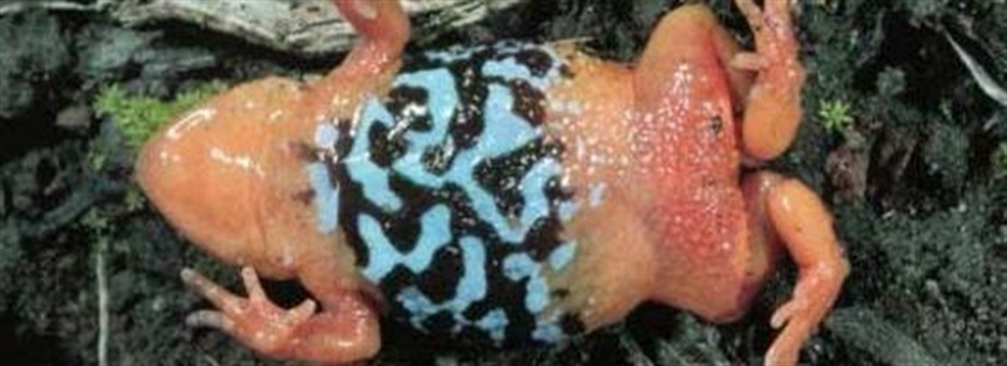
Western Port Woodland is a refuge for many threatened species The Western Port Woodlands are home to 6 endangered Ecological Vegetation Communities, 7 EPBC listed faunal species, 3 EPBC listed floral species, 14 FFG listed faunal species and 3 FFG listed floral species, plus many more vulnerable species.
Frogs Southern/marbled Toadlet Pseudophryne semimarmorata It walks rather than jumps, calls in autumn, and as you can see below its distribution is in The Bass Coast Area.

Slide 33
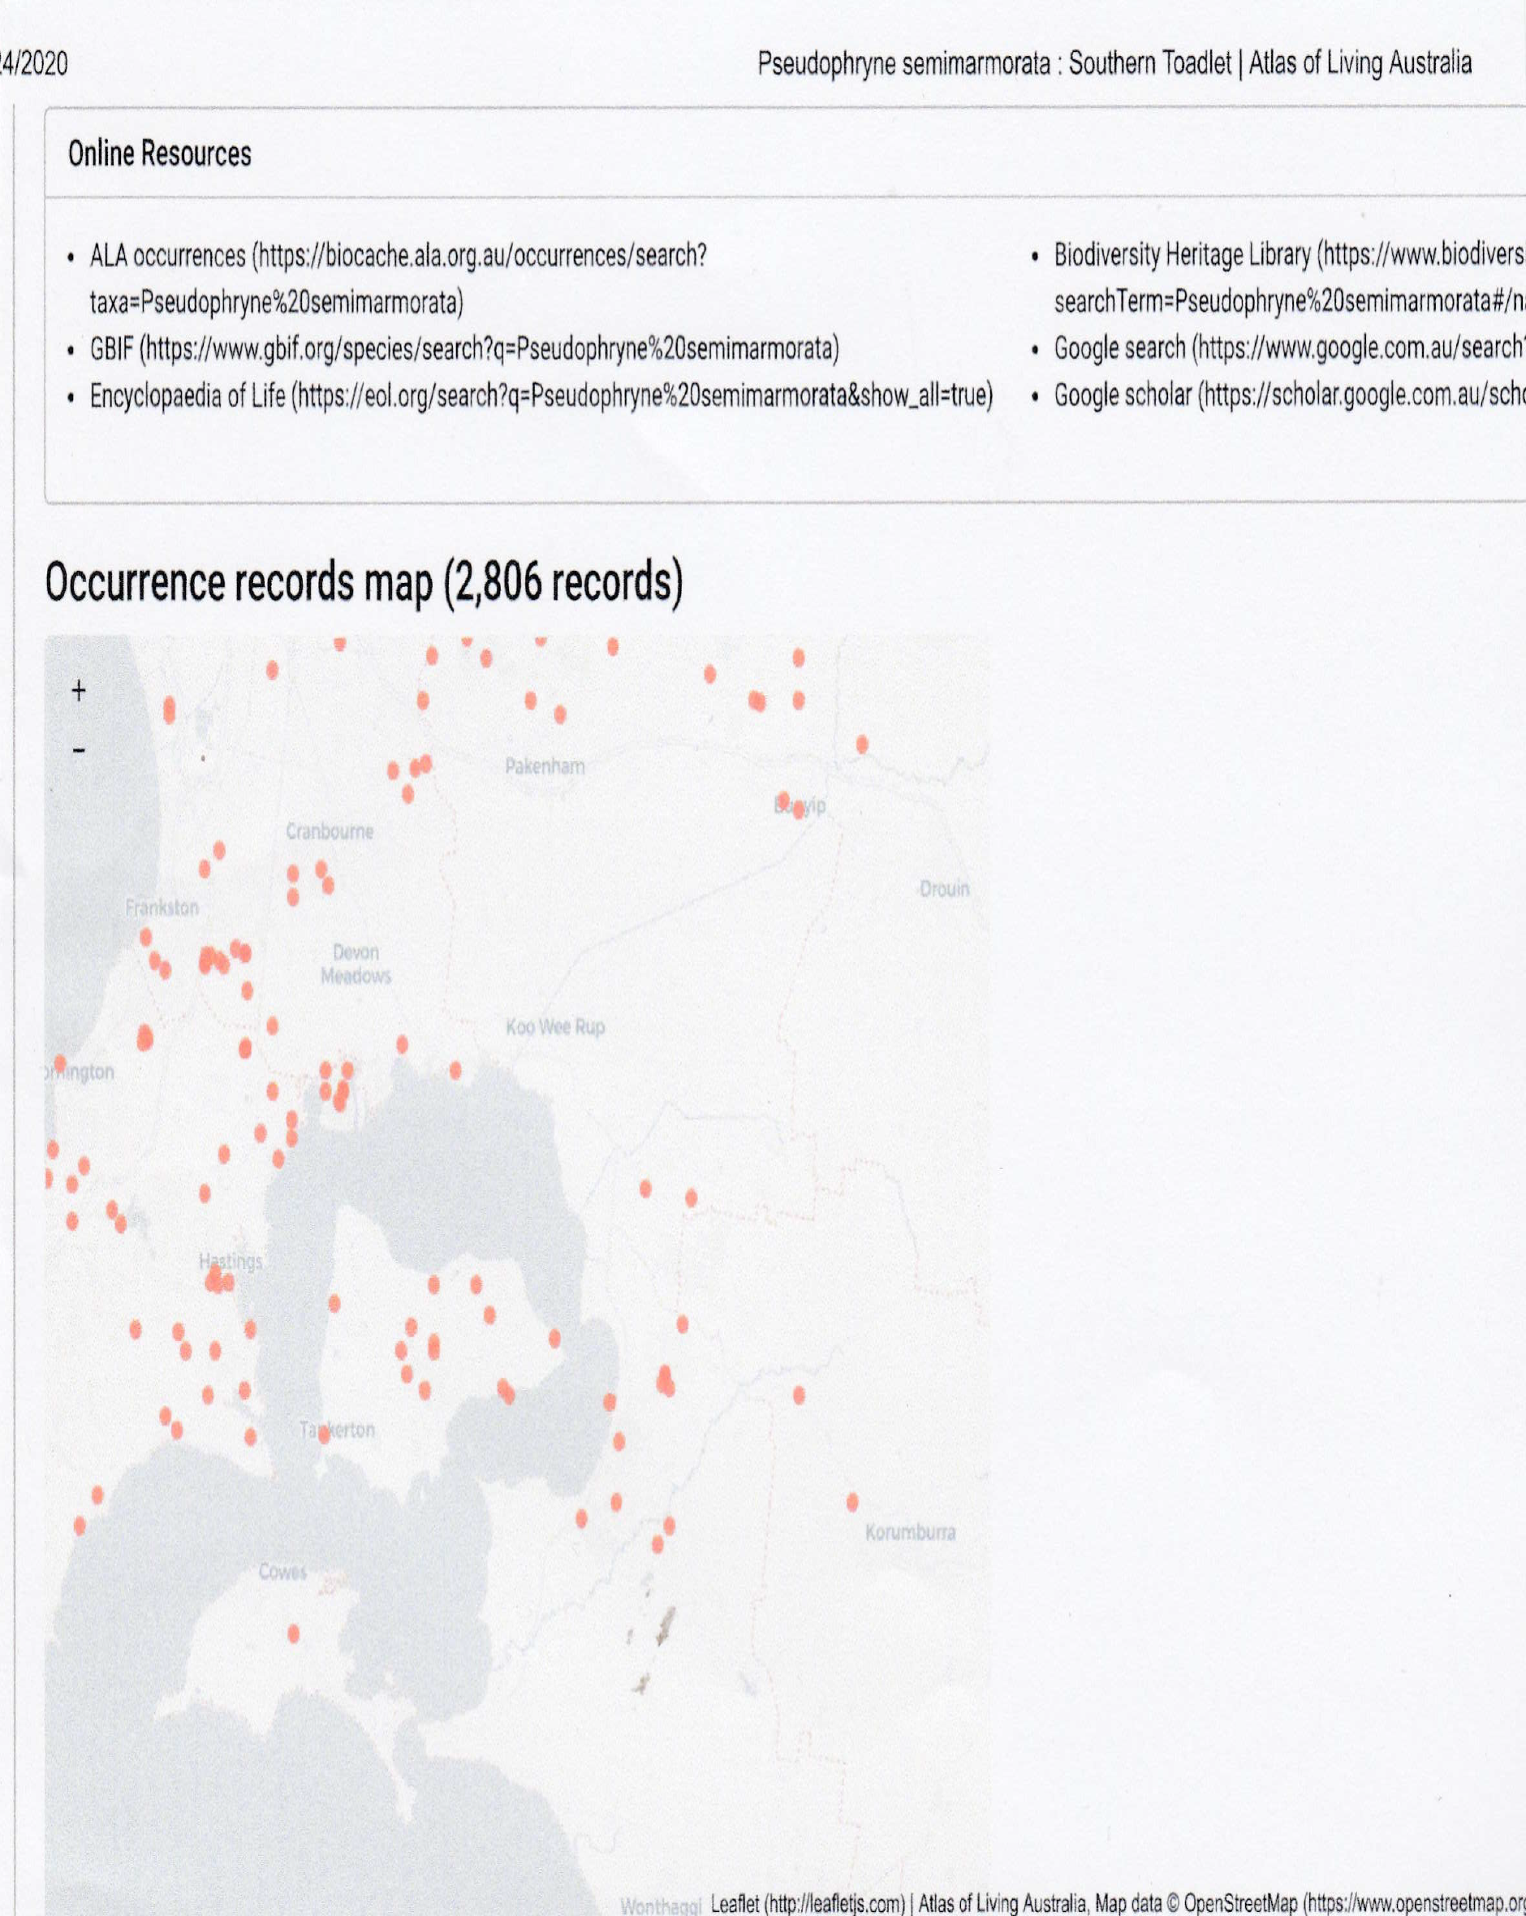

Slide 34
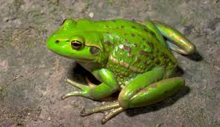
Growling Grass Frog: also known as the Green and Golden Frog, the Warty Bell Frog and Southern Bell Frog. It has a range that includes the Bass Coast.
Litoria raniformis is a largely aquatic frog distributed across south-eastern Australia. Formerly abundant, it is now listed as endangered on the IUCN Red List.
Any viable population is considered to be an important population for the persistence and recovery of the growling grass frog. For this species, a viable population is one which is not isolated from other populations or water bodies, such that it has the opportunity to interact with other nearby populations or has the ability to establish new populations when water bodies fill and become available.

Slide 35
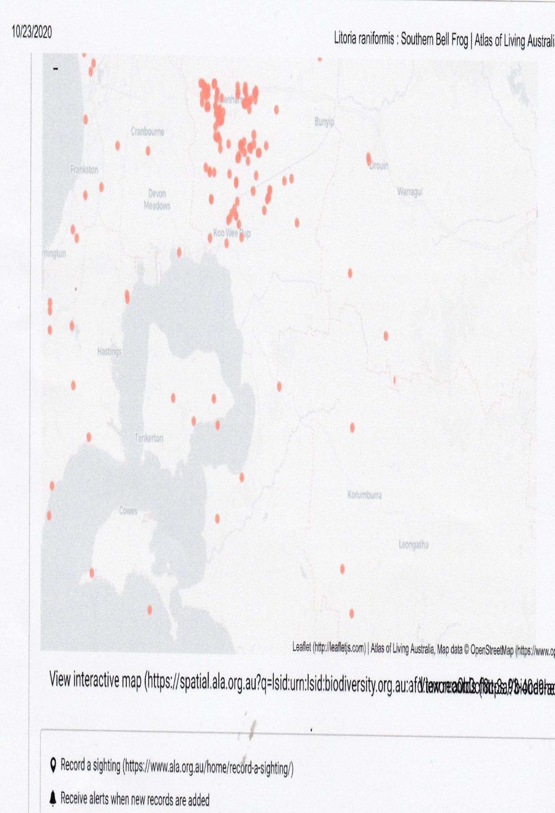

Slide 36
Ad Hoc Private commercial interests should not dictate planning. Biodiversity needs to be prioritised with every planning document. Some planning has been compromised in the region: for example the bribery scandal involving developers and Casey Councillors. It is very important to undo some of the bad planning in the past by making each document as wholistic as possible.
There is no imperative to mine in bushland rather than cheap, available, farmland handy to Melbourne. Don’t confuse a land-use conflict with a policy conflict. The 1996 Lang Lang to Grantville Regional Sand Extraction Strategy was a long time ago and these mine areas do not have ‘Manageable environmental constraints,” so action, though tricky, is clearly justified. It’s crucial that the panel gives a clear direction to the Minister on future protection. Community groups may well provide the legal path forward but perhaps the panel could seek legal advice.

Slide 37
The opportunity cost of losing an asset such as a The Westernport Woodlands is too great.
Saving the Westernport Woodlands as a National Park is a gain for biodiversity, for the education sector, for health and recreation and tourism, and The State Government who would celebrate progress in all these areas.
It is a gain not only for The Bass Coast Region but The South East of Melbourne, The Westernport Catchment and West and South Gippsland; and a win for common sense.

